Slide 1

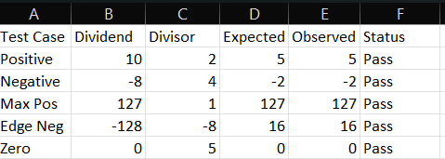
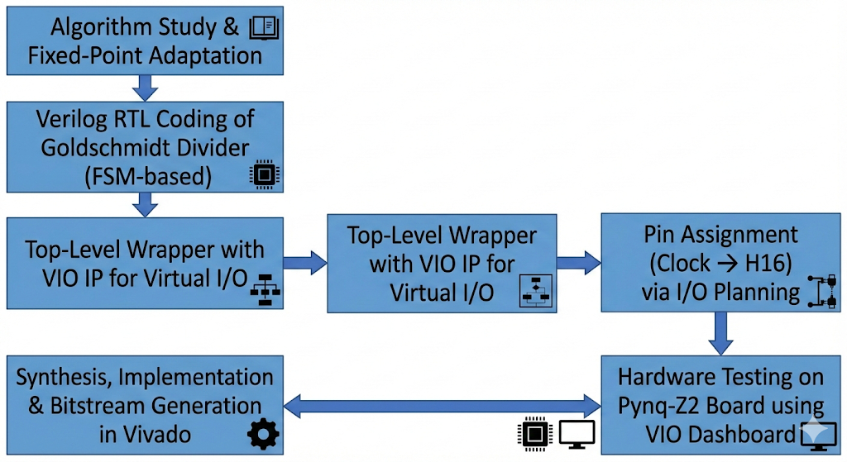
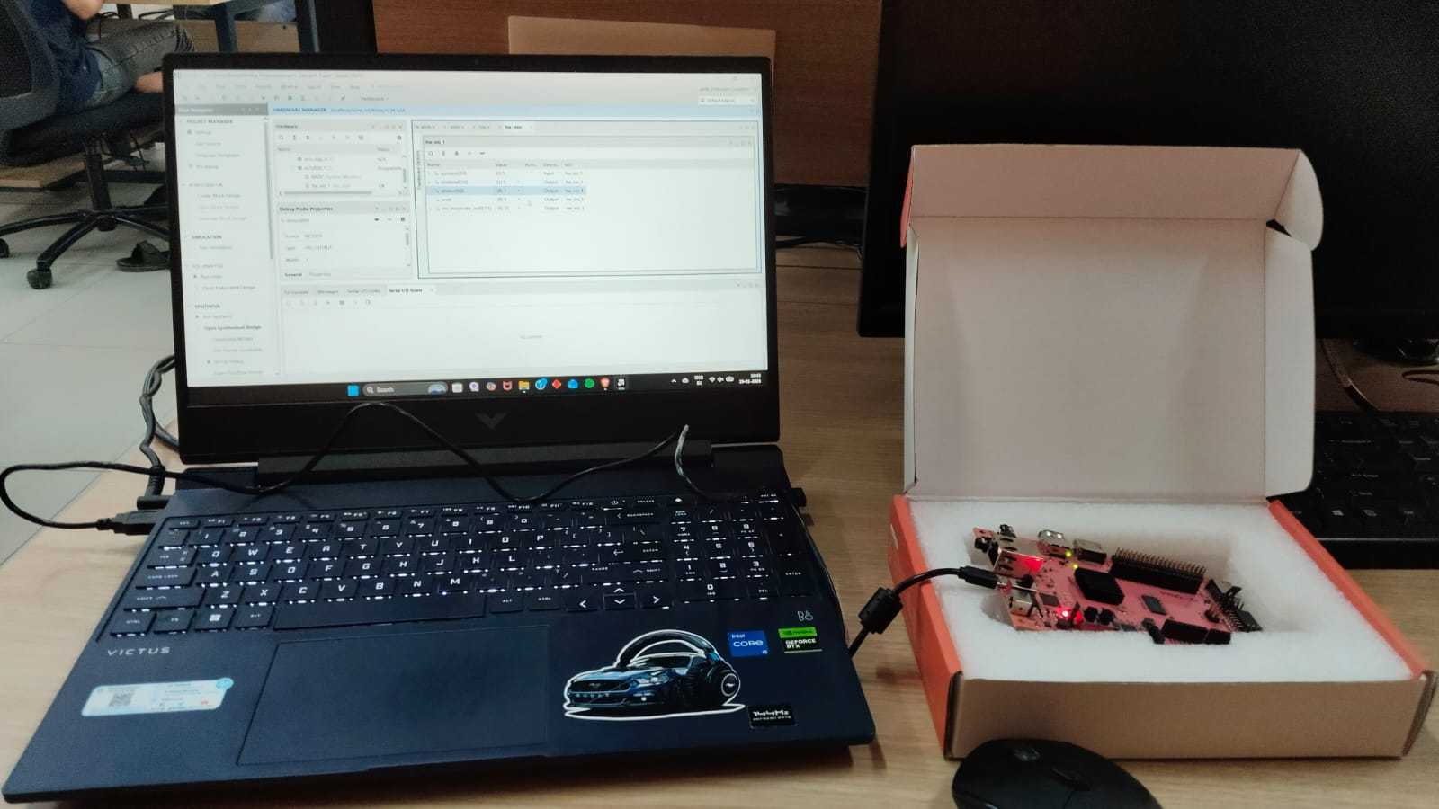
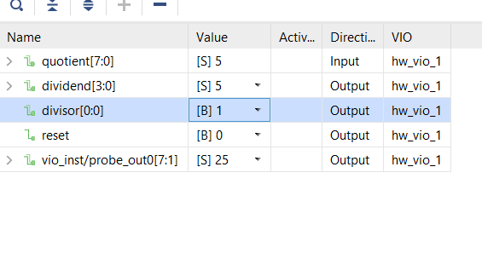

RV College of Engineering, Bengaluru – 560059.
Go, change the world
Project Title: Design of Divider Circuit with 8-Bit Dividend and 4-Bit Divisor Using Goldschmidt Division Algorithm: Implementation on FPGA and Functionality Verification
Amrut R | Anurag | Bhavesh S
1RV24EC025 | 1RV24EC031 | 1RV24EC044
Batch :ECE A
Introduction
Results & Discussions
Division is a fundamental but resource-intensive arithmetic operation in digital systems. Traditional digit-recurrence methods (restoring/non-restoring) are slow for hardware implementation. The Goldschmidt algorithm offers a fast, multiplication-based alternative that converges quadratically.
This project designs a signed 8-bit dividend ÷ 4-bit divisor divider using the Goldschmidt method, implemented in Verilog, synthesized, and verified on the Pynq-Z2 FPGA board using Virtual Input/Output (VIO) for testing.
Simulation Results (Vivado Simulator) All test vectors produced correct integer quotients with proper sign handling. Convergence achieved in 4 iterations (error < 1 LSB for 8-bit output).
Hardware Results (Pynq-Z2 FPGA + VIO) Real-time quotient observed via VIO dashboard after reset release. Stable operation when Ethernet cable is connected (prevents CLK125 glitches).
Objectives
To design an 8-bit × 4-bit signed divider using the Goldschmidt iterative algorithm in Verilog HDL.
To implement fixed-point (16.16) arithmetic with normalization and 4 iterations for convergence.
To integrate the design on Pynq-Z2 FPGA using Vivado tools.
To verify functionality through simulation and on-board hardware testing with VIO.
Goldschmidt algorithm provides fast convergence compared to restoring division.
Fixed 4 iterations ensure 8-bit accuracy with low hardware overhead.
VIO effectively replaces limited physical I/O on Pynq-Z2.
Limitation: No remainder output; no overflow detection implemented.
Methodology
Testing/Validation & Feedback
FPGA Resources: <5% LUTs / Flip-Flops utilized (XC7Z020)
Latency: ~100–150 ns (4 iterations at 125 MHz clock)
No divide-by-zero crashes (design skips if divisor = 0)
Measurable Outcomes
100% accuracy across multiple test cases (positive, negative, edge, and zero inputs) in both Vivado simulation and real-time hardware testing on the Pynq-Z2 FPGA board.
Correct sign handling and quotient computation verified (e.g., 10 ÷ 2 = 5, -8 ÷ 4 = -2, -128 ÷ -8 = 16).
FPGA resource usage remained below 5% of LUTs and Flip-Flops on the XC7Z020 device.
Virtual Input/Output (VIO) enabled complete virtual control and monitoring without physical I/O limitations.
Empirical, Calculations, Tools & Techniques
Fixed-Point Representation 16.16 format (32-bit signed registers): Dividend → {8'b0, abs dividend, 16'b0} Divisor → {12'b0, abs divisor, 16'b0}
Normalization Shift N and D until D ∈ [0x8000, 0x18000) (≈ 0.5 to 1.5 in fixed-point) Ensures quadratic convergence
Core Iteration Equations F = 0x0002_0000 – D N ← (N × F) >> 16 D ← (D × F) >> 16 Repeated for 4 iterations → sufficient for 8-bit accuracy
Sign Handling result sign = dividend[7] XOR divisor[3] Quotient = ± (final N[23:16] + rounding bit N[15])
Tools Used
Design & Synthesis: Xilinx Vivado 2023.2 / 2024.x
Clock: 125 MHz external (pin H16)
Key Techniques
Finite State Machine (5 states: sign/abs, load, normalize, F compute, iterate)
Combinational multiplier for fast updates
VIO for virtual control & observation (bypassing limited physical I/O)
Virtual I/O: VIO IP core (1 input probe, 3 output probes)
Hardware Description: Verilog HDL
Target Board: Pynq-Z2 (Xilinx XC7Z020-CLG400-1 FPGA)
References
1)Hardware Divider Based on Goldschmidt Algorithm for FPGA Implementation
Olga I. Bureneva,Alexander P. Pavlov and others
2)Design and synthesis of Goldschmidt algorithm based floating point divider on FPGA
Naginder Singh; Trailokya Nath Sasamal and others
QR codes
QR Code of Demonstration of the prototype /design simulation

